Slide 1
MIU Helpdesk
An online helpdesk to solve all student issues

Slide 2
Group Members
612377 | Pierrot Babu Ngimbidi
612413 | Boaz Turyahikayo
612373 | Addisu Damena Alemu

Slide 3
Problem statement
User (Student) problems qualifications
Many resources to use for contacting
Lack of correct information

Slide 4
Proposed solution
Helpdesk System that will help resolve problem
The user generates a query in form of a ticket to the system manager who then qualifies it and sends it to the appropriate agent/department to handle

Slide 5
Advantages
Gain of time
No need to contact various persons or services for one problem
Share information correctly between different services

Slide 6
Use Cases
Login
View Tickets
Create new Ticket
Assign ticket
Solve and close ticket

Slide 7
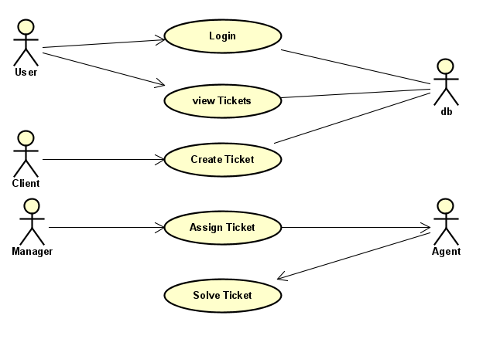
UseCase Diagram

Slide 8
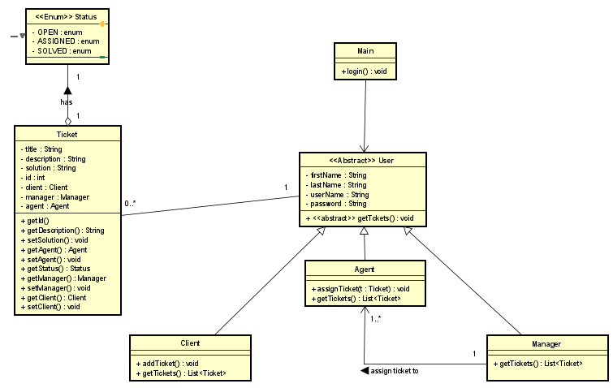
Class Diagram

Slide 9
Tools
Astah UML
GitHub
Eclipse + JavaFx
mySQL Workbench

Slide 10
Design Patterns Used
Factory
Singleton
MVC

